Slide 1
LECTURE 25
Java Input/Output System

Slide 2
STREAMS
Java program perform I/O through streams.
Stream is an abstraction that hides the details of the physical devices which are involved in I/O operation.
A stream is linked to a physical device by the java I/O system.
In java objects are used to represent streams of data.
In a program, we read information from an input stream and write information to an output stream

Slide 3
I/O STREAM
The java.io package contains many classes that allow us to define various streams with particular characteristics
Two types of I/O streams:
-byte streams and –character streams.

Slide 4
Byte Stream
Used to handle input and output of bytes.
Used when reading and writing binary data.
Character Stream
Used to handle input and output of characters.
Use Unicode and can be internationalized.

Slide 5
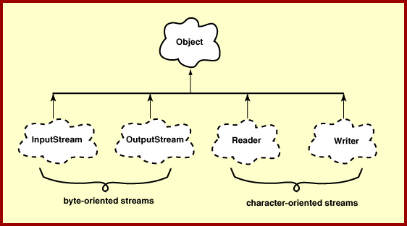
TOP I/O HIERARCHY

Slide 6
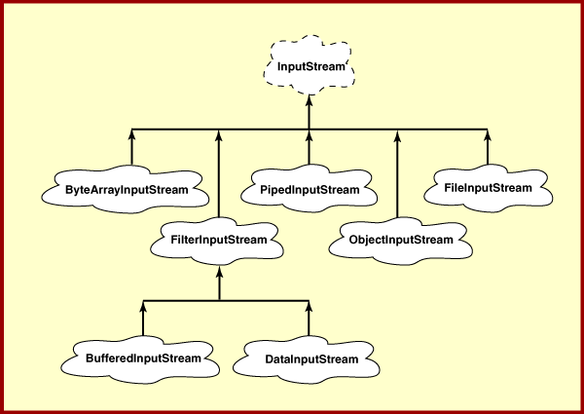
INPUT STREAM (BYTE STREAM)

Slide 7
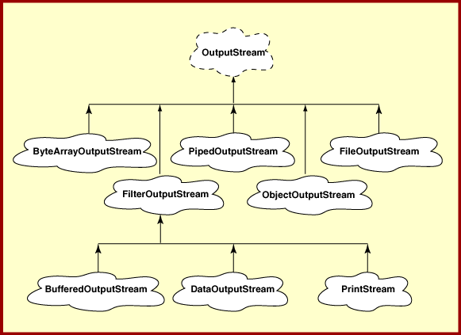
OUTPUT STREAM (OUTPUT STREAM)

Slide 8
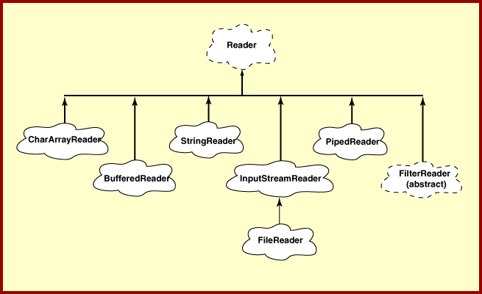
READER (CHARACTER STREAM)

Slide 9
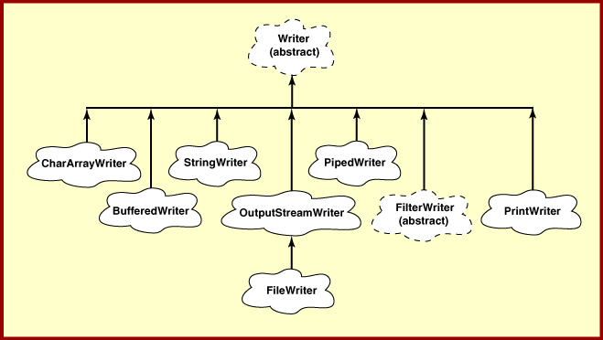
WRITER (CHARACTER STREAM)

Slide 10
THE PREDEFINED STREAM
java.lang contains a class named System.
System contains 3 predefined stream variables: in, out and err. They are declared public, static and final.
System.in- standard input stream.
- an object of type InputStream
System.out- standard output stream.
-an object of type PrintStream.
System.err- standard error stream.
- an object of type PrintStream.

Slide 11
READING CONSOLE INPUT
BufferedReader in=
new BufferedReader(new InputStreamReader(System.in));
InputStreamReader(InputStream in);
InputStreamReader converts the byte input stream to a character
input stream.
BufferedReader supports a buffered stream.
BufferedReader(Reader in)
Reader
InputStreamReader

Slide 12
Reading Characters:
int read( ) throws IOException
- it reads a character from the input stream and returns it as integer value.
- It returns -1 when the end of the stream is encountered.
Reading Strings:
String readLine() throws IOException

Slide 13
EXAMPLE- READING STRING FROM THE KEYBOARD
import java.io.*;
class java_io
{
public static void main(String arags[]) throws IOException
{
String str;
BufferedReader br = new BufferedReader(new InputStreamReader(System.in));
System.out.println("Enter input:");
do
{
str=br.readLine();
System.out.println(str);
}while(!str.equals("stop"));
}
}

Slide 14
EXCEPTIONS
IOException:
-Signals that an I/O exception of some sort has occurred.
-checked exception.(use throws or catch statement)

Slide 15
INPUTSTREAM
Is an abstract class.
It implements the AutoCloseable and Closeable interface.
All the methods throw an IOException on error condition.
Closable Interface:
Belongs to java.io.
Objects of a class that implements Closable can be closed.
It defines:
void close() throws IOException

Slide 16
METHODS DEFINED BY INPUTSTREAM
read() ------- Reads a byte from the input stream and return integer representation
read (byte b[])------Reads an array of bytes into b
read ( byte b[], int n, int m)---Reads m bytes into b starting from n th byte.
available()------ gives number of bytes available in the input
skip(long n)-------Skips over n bytes from the input stream.
mark(int m)--- places a mark at the current position in the input stream that will remain valid until m bytes are read.
reset()-----resets the input pointer to the previously set mark,
close()---- Closes the input stream.
Note:
All the methods except mark() and reset() methods are implemented by the subclasses of InputStream.

Slide 17
READER
An abstract class.
Implements AutoCloseable, Closable and Readable interface.
Readable Interface:
Indicates an object that can be used as a source for characters.
It defines:
int read(charBuffer buf)
reads characters into buf. It returns the number of characters read or -1 if an EOF is encountered.
Belongs to java.nio

Slide 18
METHODS DEFINED BY READER
read() ------- Reads a character from the stream and return integer representation
read (char b[])------Reads an array of characters into b
read ( char b[], int n, int m)---Reads m characters into b starting from nth position.
skip(long n)-------Skips over n characters from the input stream.
mark(int m)--- places a mark at the current position in the input stream that will remain valid until m characters are read.
reset()-----resets the input pointer to the previously set mark,
close()---- Closes the input stream.
Note:
All the methods throw IOException on error condition.

Slide 19
OUTPUTSTREAM (BYTE STREAM)
An Abstract class.
It implements AutoClosable, Closable and Flushable interface.
All the methods in this class return void and throw an IOException in the case of errors.
Flushable Interface:
Defined in java.io.
It defines:
void flush() throws IOException
Flushing a stream typically causes buffered output to be physically written to the underlying device

Slide 20
METHODS DEFINED BY OUTPUTSTREAM
void close()--- closes the output stream.
void flush()--- it flushes the output buffers.
void write( int b) --- writes a single byte to an output stream.
void write ( byte buff[]) --- writes a complete array of bytes to an output stream.
void write ( byte buff[], int offset, int numbytes) --- writes the numbytes bytes from the array buff beginning at buff [offset].

Slide 21
WRITER (CHARACTER OUTPUT STREAM)
An abstract class.
Implements AutoCloseable, Closeable, Flushable and Appendable interfaces.
Appendable Interface:
Belongs to java.lang.
Objects of a class that implements Appendable can have a character or character sequences appended to it.
It defines;
1. Appendable append(char ch) throws IOException
2. Appendable append(CharSequence chars) throws IOException
3. Appendable append(CharSequence chars, int begin, int end) throws IOException

Slide 22
USEFUL METHODS OF WRITER
void close()--- closes the output stream.
void flush()--- it flushes the output buffers.
void write( int b) --- writes a single character to an output stream.
void write ( char buff[]) --- writes a complete array of characters to an output stream.
void write ( char buff[], int offset, int numbytes) --- writes the numbytes characters from the array buff beginning at buff [offset].
void write (String str)--- Writes str to the invoking output stream.
Writer append (char ch)– Appends ch to the end of the output stream
Writer append(CharSequence ch)– Appends ch to the end of the output stream.

Slide 23
FILE CLASS
Belongs to java.io.
It is used to obtain or manipulate the information associated with a disk file.
A directory in java is treated simply as a File object with one additional property- a list of file name can be examined by the list() method.

Slide 24
CONSTRUCTORS OF FILE CLASS
File (String directoryPath)
Example:
File f1 = new File(“/java”);
File (String directoryPath, String filename)
Example:
File f2 = new File(“/java”, “image.java”);
File (File dirObj, String filename)
Example:
File f3 = new File(f1, “image.java”);

Slide 25
EXAMPLE: OBTAINING STANDARD PROPERTIES OF A FILE OBJECT
import java.io.*;
class file_tst
{
public static void main(String args[])
{
File f1 = new File("/tmp/test");
System.out.println("file name: "+f1.getName());
System.out.println("file exist: "+f1.exists());
System.out.println("path: "+f1.getPath());
System.out.println("parent: "+f1.getParent());
System.out.println(f1.canWrite() ? "is writeable" : "is not writeable");
System.out.println(f1.canRead() ? "is readable" : "is not readable");
System.out.println(f1.isDirectory() ? "is a directory" : "is not a directory");
System.out.println("file size: "+f1.length()+" bytes");
}
}

Slide 26
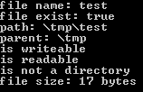
OUTPUT

Slide 27
LISTING A DIRECTORY
public void lst_dir(String d_Name)
{
File d_List = new File(d_Name);
String[] lst = d_List.list();
for(int i = 0; i < lst.length; i++)
System.out.println(lst[i]);
}
String[] list : Returns an array of strings naming the files and directories in the
directory denoted by this abstract pathname.

